Slide 1
The Value of Location: What Matters Most for Older Individuals Considering Relocation in Sweden?

Slide 2
DCE – a recap
Respondents were asked to select the most attractive housing options between two alternatives in a choice set.
The alternatives only differed in the levels of housing attributes and price.
We use this data to estimate a model that measures the effect the attribute levels have on the probability of choosing one choice set alternative over another.
This probability is interpreted as utility – levels that increase the probability of choosing one alternative over another provide more utility.
We can further estimate willingness-to-pay values from the model coefficients.

Slide 3
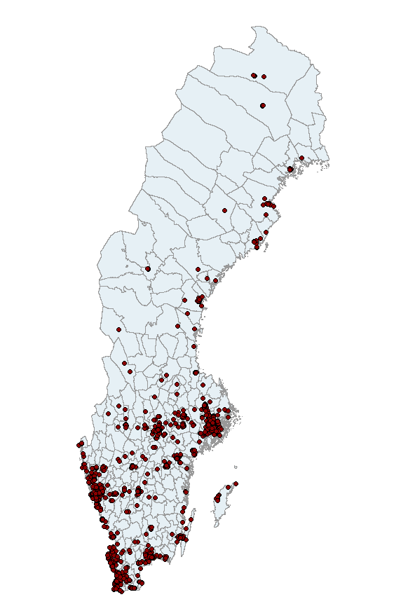
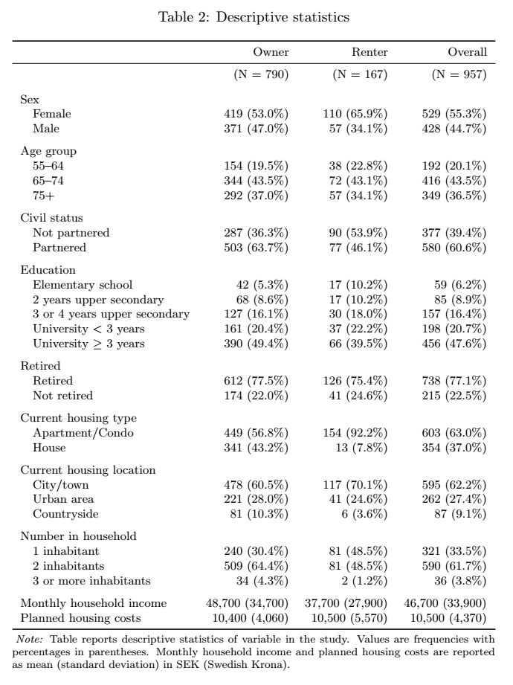

Slide 4
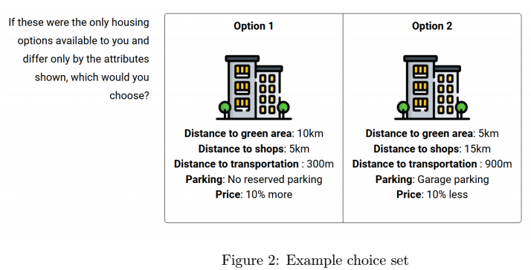
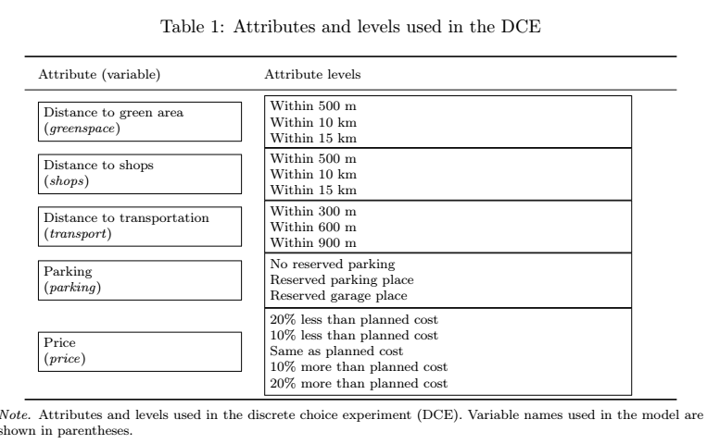

Slide 5
Analysis – What have we done so far?
Approach mirrors that of Caplan et al (2021):
Focuses on renters and owners
Estimates baseline models, calculating WTP values
Adds interaction terms that allow to sus out heterogenous effects

Slide 6
Models
Multinomial Logit (MNL) is common in discrete choice experiments
It assumes everyone values attributes the same way.
In reality, people differ and preferences vary by person or group.
Mixed Logit (ML) Models relax this restriction:
Allow individual differences in preferences.
Handle repeated choices from the same person.
Offer more realistic and flexible results.
Here we move from the “average person” to “each person has their own taste.” – Essential for us as our aim is to uncover different tastes
ML models take more time to compute as they use simulations to estimate maximum likelihood.

Slide 7
Steps to get to Willingness-to-pay
The coefficients from the Mixed logit models are given as probabilities that are interpreted as the utility each attribute provides.
These estimates is not very interpretable but we can compare the significance and magnitude of the coefficients. If a coefficient is greater(less) than another, we can say that it gives more(less) utility, or that it is more (less) important than others
Estimating willingness-to-pay values lets us compare the utility of the coefficients in a standardized way.
Recall that the price coefficient is in percentage terms in 10% intervals
Divide the level coefficients by the price coefficient to get a Marginal rate of substitution (MRS). This represents the percentage change (in 10% intervals) respondents are willing to pay for an attribute level.
Divide the MRS by 10 (to adjust for the 10% intervals) and multiply by the average planned housing cost to get a Marginal Willingness-to-Pay (MWTP) value in Swedish krona.

Slide 8
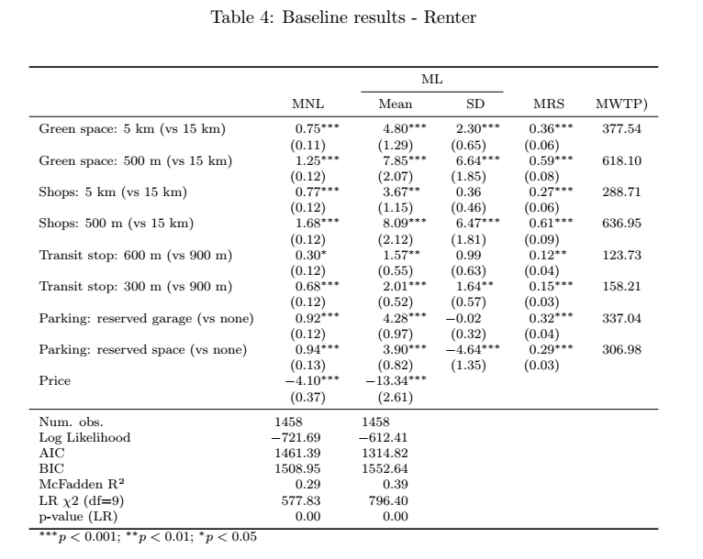




MRS = 8.09 / 13.34 = 0.61
MWTP = 0.61 / 10 x 10500 ≈ 636
”Renters are willing to pay 636 sek a month to be closer to shops”
”Renters on average are willing to pay 636 more a month to reside within 500m of shops instead of 15km away from shops”

Slide 9
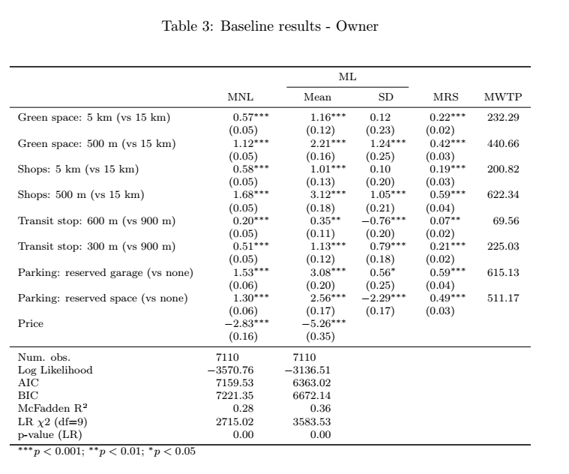






”Owners are willing to pay 278 sek more a month than Renters (615-337) to have a reserved garaged space (compared to none)”

Slide 10
Adding interaction terms
Splitting the sample into subsamples and running test on each one is one strategy for uncovering differences in our sample. (i.e. Renters vs. Owners)
Alternatively, we can run one model on the entire sample and add interaction terms with the attribute levels and a dummy group variable.
This allows us to test if the differences are significant.
Unfortunately, interpretation gets a bit muddy with many interaction terms. A binary variable offers the cleanest interpretation compared to catergorical variables with more than two levels.
Note: the unit of analysis is at the choice level, not the individual. This means we cannot add control variables as in traditional regression models as they do not fluctuate between the choice alternatives. Any individual level variables (sex, education, etc) can only be entered into the model as interactions with the attribute levels.

Slide 11
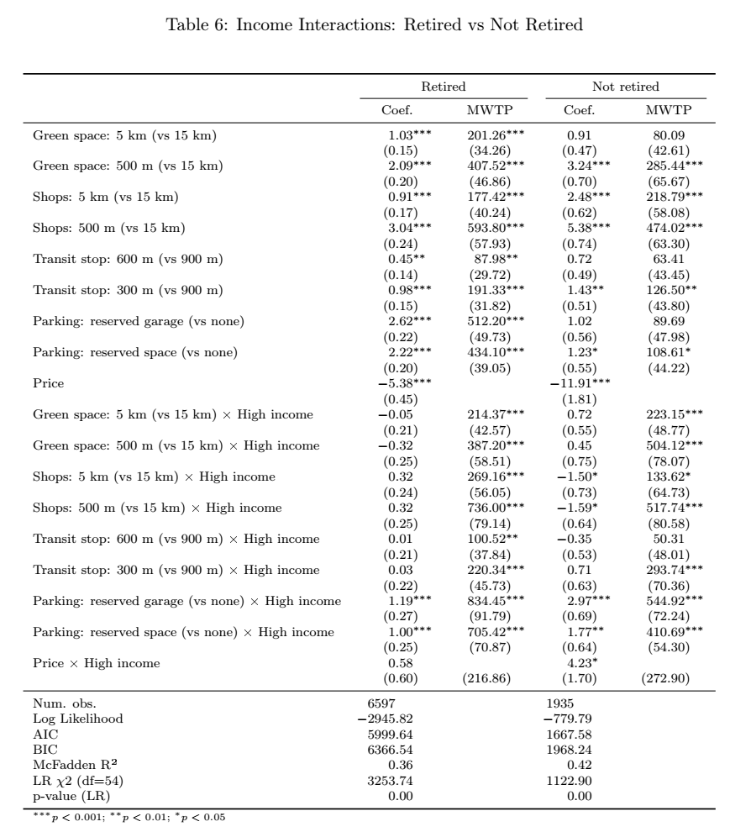
High income > 40500 sek a month (median of sample)
Here we extend the baseline tests, adding interaction terms of a new variable High Income and the attribute levels. We also split the sample to those who are Retired and Not retired.
Recall that for categorical variables, they are interpreted in comparison to a reference (base) level.
Adding interactions adds another level of complexity in interpretation. We are now comparing the coefficients with the attribute reference level (no parking vs garage) AND the base level of the added variable – here High Income.
Here, a correct interpretation would be:
”Retired individuals with a Higher income are willing to pay 322 more for a reserved garage place than those with a lower income (834-512) . Among those not retired, High income individuals are willing to pay almost twice as much (504 vs 285) to be closer to green areas”

Slide 12
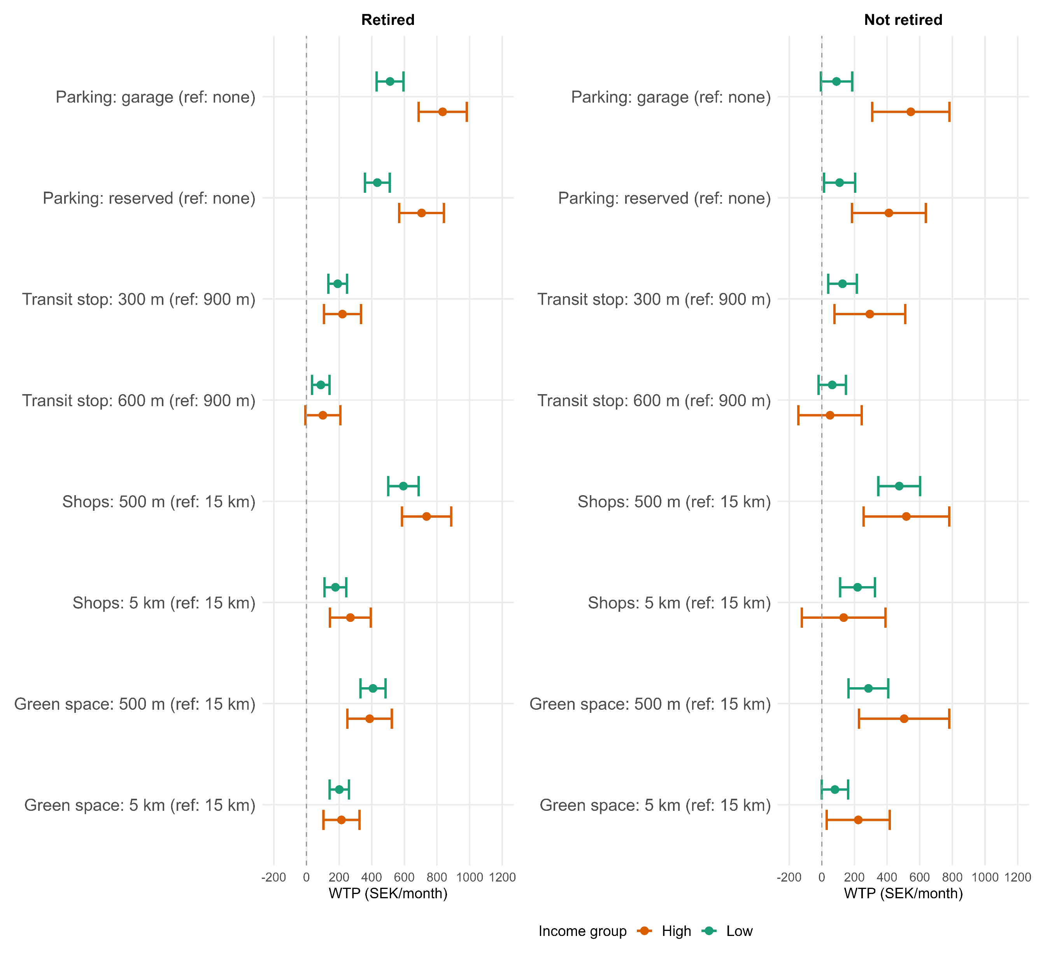
High income > 40500 sek a month (median of sample)

Slide 13
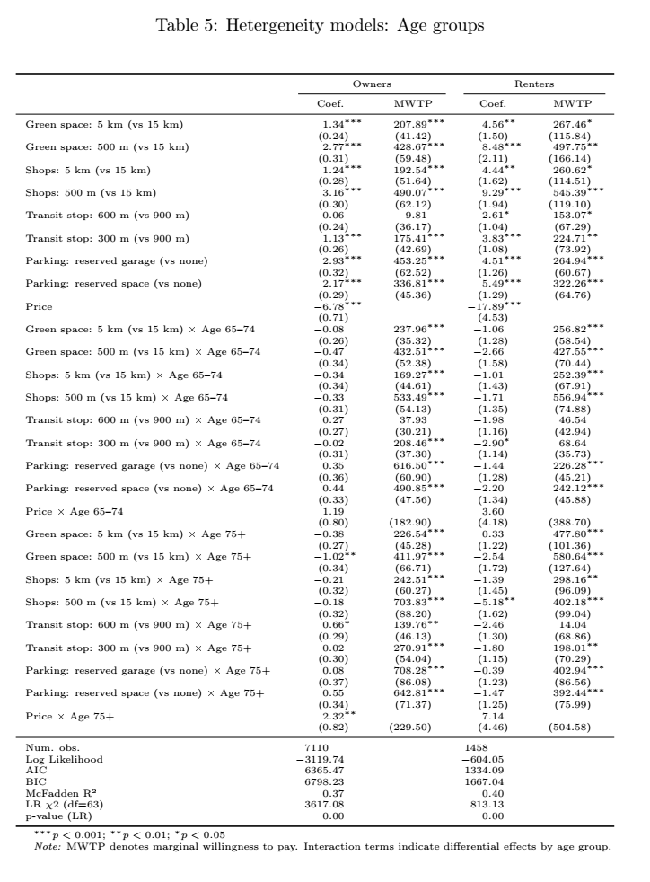
Adding interactions with more than three levels is informative, but can be more complex to interpret correctly.
Here, a correct interpretation would be:
”Among the Renters willing to pay more for a reserved garage place, those aged 55-64 are willing to pay 264 sek more, those aged 65-74 are willing to pay 226 sek more, and those aged 75+ are willing to pay 402 sek more a month”
Interpretation becomes less straight-forward…

Slide 14
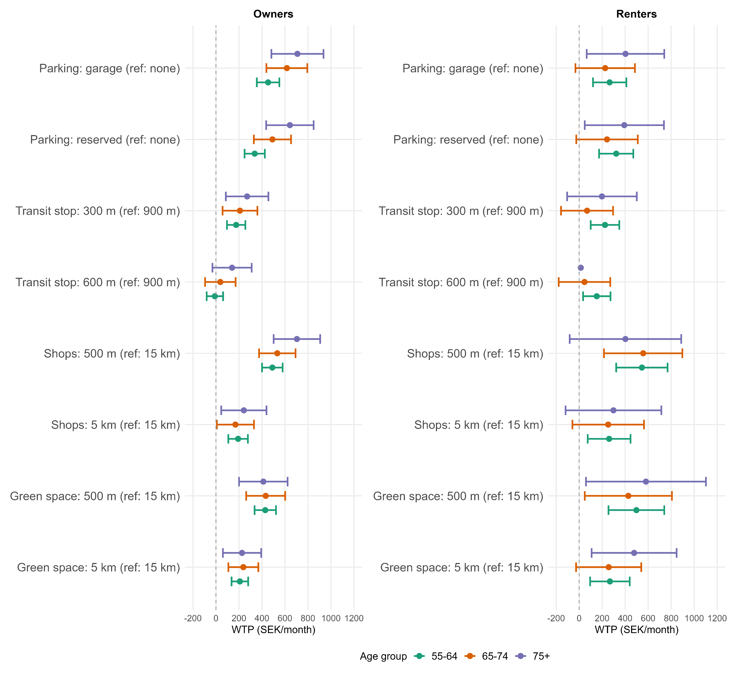

Slide 15
Questions – some food for thought
How to connect why locational preferences matter for ageing and housing policy?
Are we overly focused on methodology and not on ageing insights?
More emphasis on policy relevance or behavioral interpretation?
Connection to RELOC-AGE aims and to concepts in gerontology?
Can you share any sources, frameworks, concepts from ageing and health to strengthen the paper?
How to “slice and dice” the data, is the focus on Renters vs Owners or something more specific?
Men vs Women?
Retired vs non-retired?
Age groups?

